Slide 1


Slide 2
StudioML Meta-Data / ENN Use Cases
ENN Use Cases not addressed
studio ui usage
Experiment meta-data only accessible from the researchers CLI
Meta-data generated needs to be included in studioml artifacts
Projects vs Experiments
Completion service is key to ENN but not leveraged by studioml tooling including zoo
Workflow model needed for session servers to scale past single digit numbers of generations
Life Cycle
Projects are loosely defined and not used for queries etc, no notion of tenants, cost centers
Downstream tooling integration points/interface needed to be made available

Slide 3
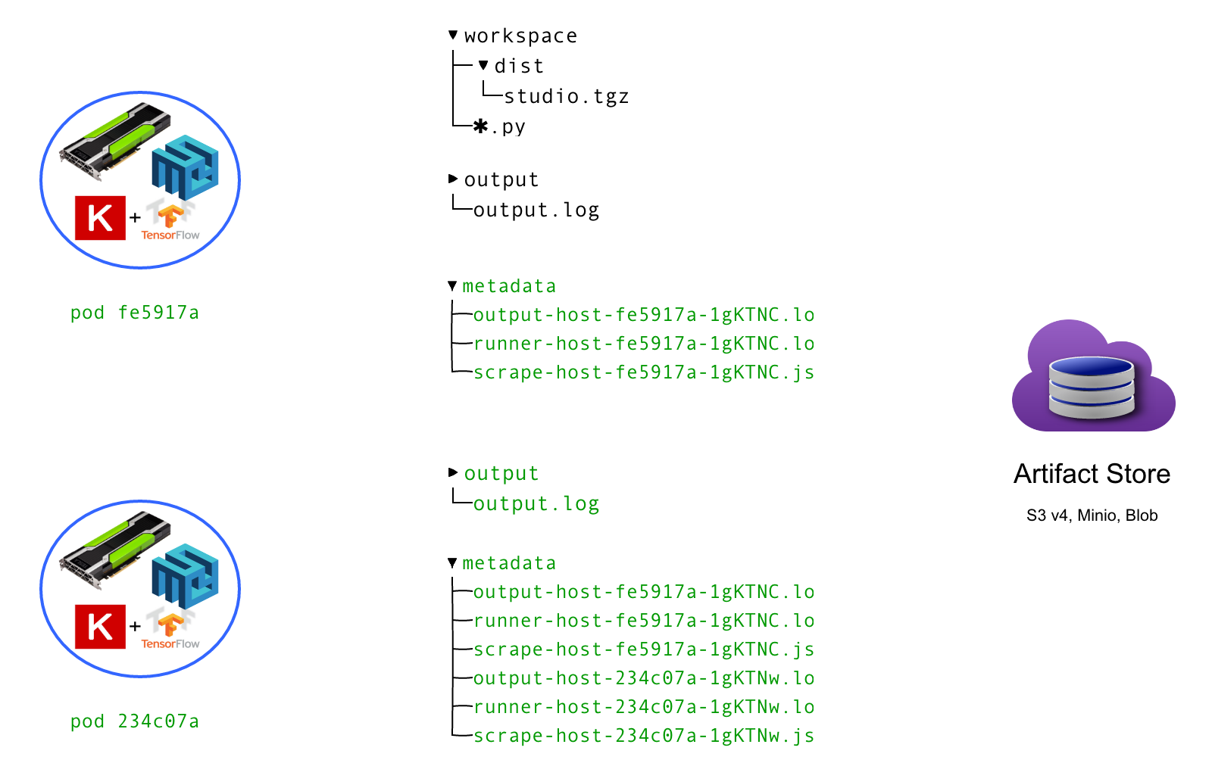

Slide 4
{ ”experiment": {"fitness": 0.98, ”custom": ”custom_value" } } | v minio hosted metadata *.json files | V Users Document storage caching | v json query engine (Zorba / Data lake¹) | v UI Tooling, Session Server
¹ https://blog.minio.io/modern-data-lake-with-minio-part-1-716a49499533

Slide 5
1H19 Project Strawman
meta-data project
JSON support for meta-data scraping from experiments (draft-handrews-json-schema-*) ✔
ETL downstream exporting ✔
ETL style ingest and standalone¹ reporting tool
Socialize and discover downstream opportunities within C-Corp
Workflow daemon / service
Kubernetes hosted fire and forget session server
Projects states
Pipeline capabilities
¹ statically linked Linux single binary

